Slide 1
A Stock Market Prediction System based on Learning from Historical Prices and Customer Reviews

Slide 2
Table of Contents
01
Introduction
02
System Components and Architecture
03
Front End Development
04
Back End Development
05
Historical Data and Prediction
06
Twitter Sentimental Analysis
07
Natural language processing (NLP)
08
Enhancement
09
Future Work

Slide 3
01
Introduction

Slide 4
Prediction of stocks is generally believed to be a very difficult task. In fact, stock market price prediction is very fluctuating in nature. They depend on various factors like the previous stock prices, current market trends, financial news, competitor’s performance etc.
For successful investment, many investors are interested in knowing about the future situation of the market. Effective prediction systems indirectly help traders by providing supportive information such as the future market direction. Data mining techniques are effective for forecasting future by applying various algorithms to data.
Financial data of stock market is of complex nature, which makes it difficult to predict or forecast the stock market behavior.

Slide 5
Project Scope
The goal of our work was to study and analyze how the historical information and external factors might influence the future price trend of stock market companies like financial news, expert’s opinion and public sentiment from Twitter with historical stock market data and international market trend using Machine Learning techniques.
We constructed an effective model to predict stock market future trends with small error ratio and improve the accuracy of prediction.
This prediction model is based on sentiment analysis of financial news from twitter and historical stock market prices. This model provides better accuracy results considering multiple types of news related to market and company with historical stock prices.

Slide 6
02
System Components And Architecture

Slide 7
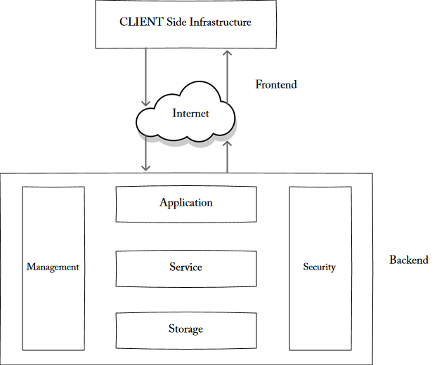
System Components And Architecture
A system architecture is the conceptual model that defines the structure, behavior, and more views of a system. A system architecture can consist of system components and the sub-systems developed, that will work together to implement the overall system.

Slide 8

This project built on Google Cloud infrastructure. Google Cloud Platform is a suite of public cloud computing services offered by Google. The platform includes a range of hosted services for compute, storage and application development that run on Google hardware. Google Cloud Platform services can be accessed by software developers, cloud administrators and other enterprise IT professionals over the public internet or through a dedicated network connection.

Slide 9
System Component
1. Google Compute Engine
Google Compute Engine delivers virtual machines running in Google’s innovative data centers and worldwide fiber network, Compute Engine’s tooling and workflow support enable scaling from single instances to global, load-balanced cloud computing
3. App Engine
Build and deploy applications on a fully managed platform. Scale your applications seamlessly from zero to planet scale without having to worry about managing the underlying infrastructure. With zero server management and zero configuration deployments, developers can focus only on building great applications without the management overhead
2. Cloud Schedule
Cloud Scheduler is a fully managed enterprise-grade cron job scheduler. It allows you to schedule virtually any job, including batch, big data jobs, cloud infrastructure operations, and more
4. BigQuery
BigQuery, Google's serverless, highly scalable enterprise data warehouse, is designed to make data analysts more productive with unmatched price-performance

Slide 10
System Architecture
The system architecture of the project is built to facilize the communication between the system components and to organize the workflow between services and machine learning model run on Google Compute Engine and the backend written on App Engine

Slide 11
Communication
Connection on the system build on a group of APIs, Compute Engine that runs the machine learning models and crawling to get updated data periodically output the needed data and store it through Google API on the database in BigQuery, App Engine which responsible for web application get the needed data from BigQuery to visualization it on the website
.
The process here of passing data between Compute Engine and App Engine through the database on BigQuery is very dynamically in no time and that’s the reason for choosing BigQuery that connect both Compute Engine and App Engine and update data, passing it, connect with other services in no-time.

Slide 12
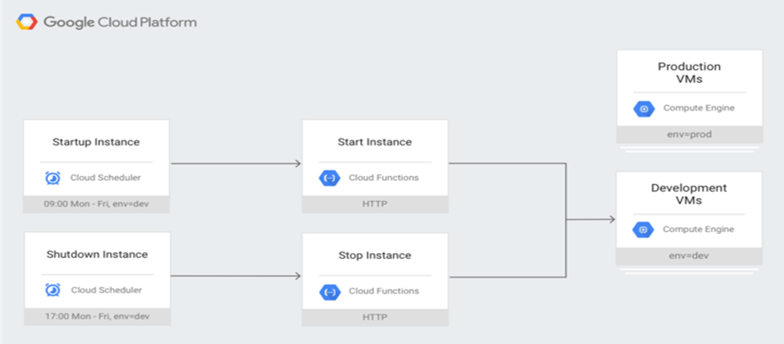
Scheduling
Back end written on App Engine isn’t connect directly with services on Compute Engine, also it isn’t effective way to schedule tasks on Compute Engine and turn the machine instance on 24 hours 7 day a week. So that the system need an upper scheduler machine that’s prepared to run a piece of code that is startup and shutdown the machine instance on schedule, and machine instance have its cron jobs that runs the models and APIs when the machine turned on.
The following diagram represent the process of schedule.

Slide 13
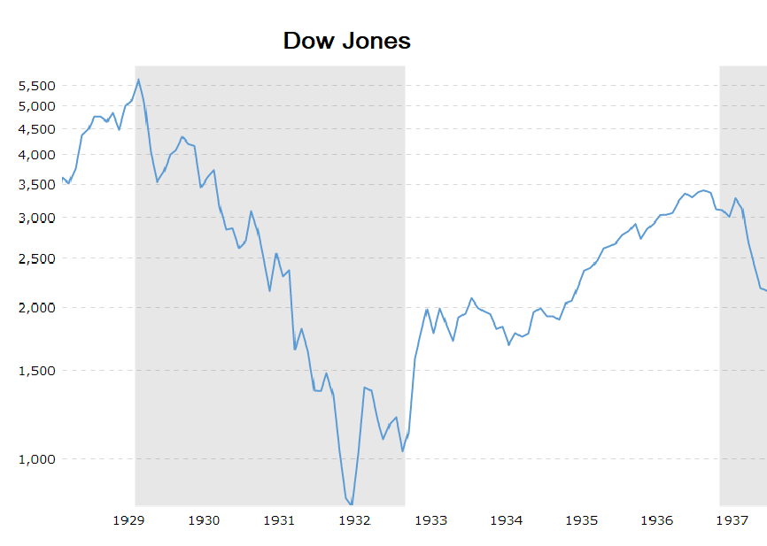
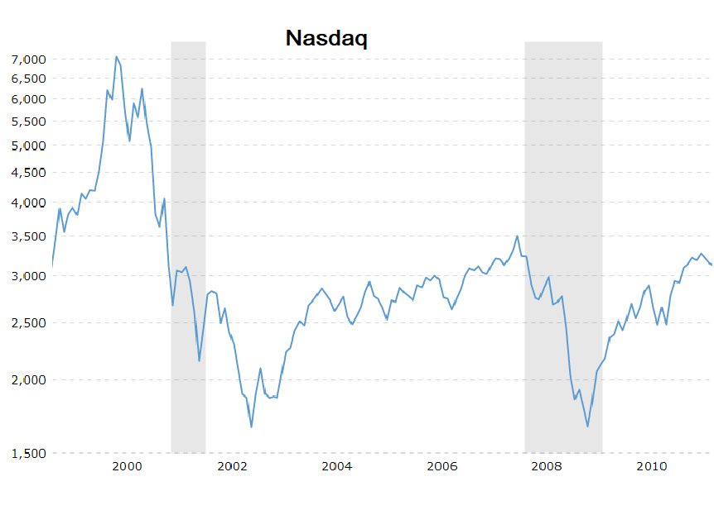
Types of Data
Historical Data
Using stock market historical data and studying specific examples from the stock market past, make it easier to put current market moves in context, while making informed decision. Reflecting on history is a vital aid in our decision-making process. In this example, notice how the Dow and NASDAQ index charts move in lockstep through their respective decades. The 1929 stock market crash reflected in Dow index overlays almost perfectly against the 2000 NASDAQ index break. It is our belief that history repeats itself in the stock market because human nature and investor psychology don’t change. Therefore, analyzing historical charts like those referenced can be a helpful guide for interpreting current and future market trends.

Slide 14
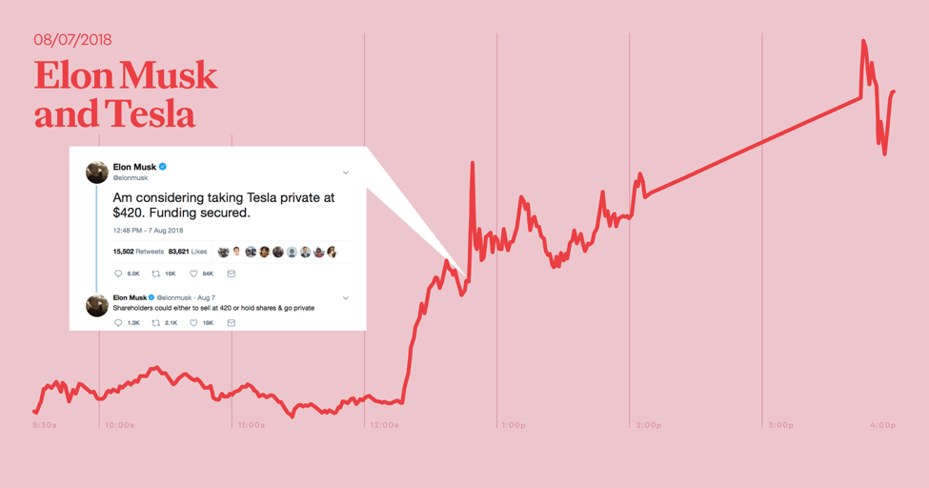
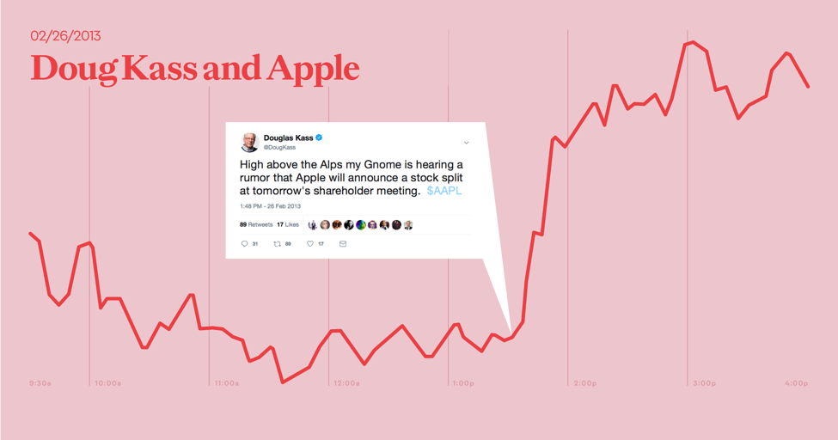
Types of Data
Tweets
Several studies show why. Blake spoor, Miller, and White (2014) suggest that Twitter influences the trading volume within the market. Another study showed that sentiment of tweets (including non-company published tweets) are associated with abnormal returns (Oh and Sheng 2011). IHS Markit, a leading financial data service provider, also found that positive social media sentiment around stocks displayed cumulative returns of 76% compared to -14% from negative sentiment stocks.

Slide 15
APIs
Historical Data
we start to use Yahoo Finance as a source of stock prices data.
Yahoo Finance is about getting financial information that is relevant to specific needs through the medium of search.
Yahoo Finance APIs in python is available in different ways and sources. And in this point, we choose pandas-datareader to become our API to crewel data from Yahoo Finance.
Tweets
To get the most effective influence of tweets, we were in need to get historical tweets and up-to-date tweets.
To work with twitter API to get up-to-date data we install some libraries like tweepy.

Slide 16
03
Front End Development

Slide 17

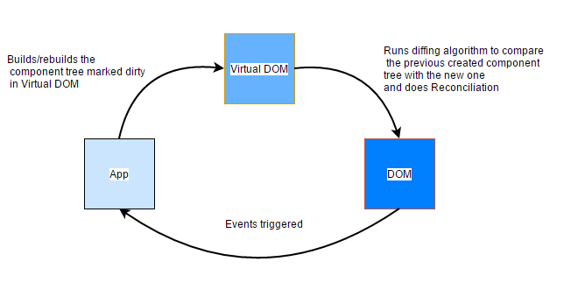
Html, css and..React js!
What is React js?
React (also known as React.js or ReactJS) is a JavaScript library for building user interfaces.
React allows developers to create large web applications which can change data, without reloading the page.
Why React js?
It’s about using reusable components.
Works with a virtual DOM.
Small Learning Curve, much less than other frameworks.
JSX, is mixing HTML and Javascript, and it works well with
react.
React has a huge community of support.

Slide 18
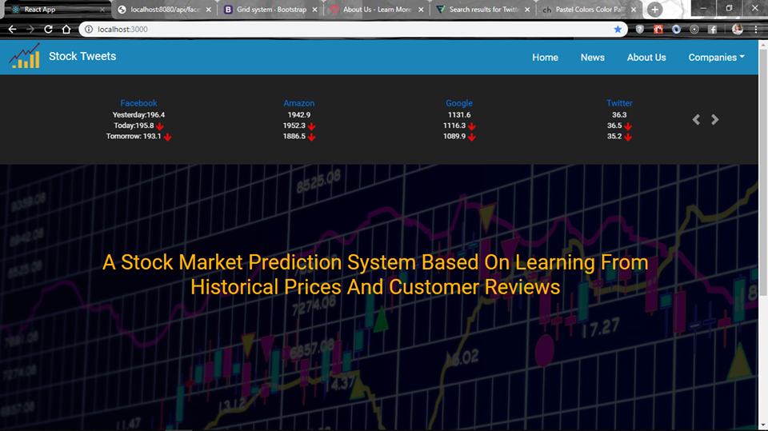
Home page

Slide 19
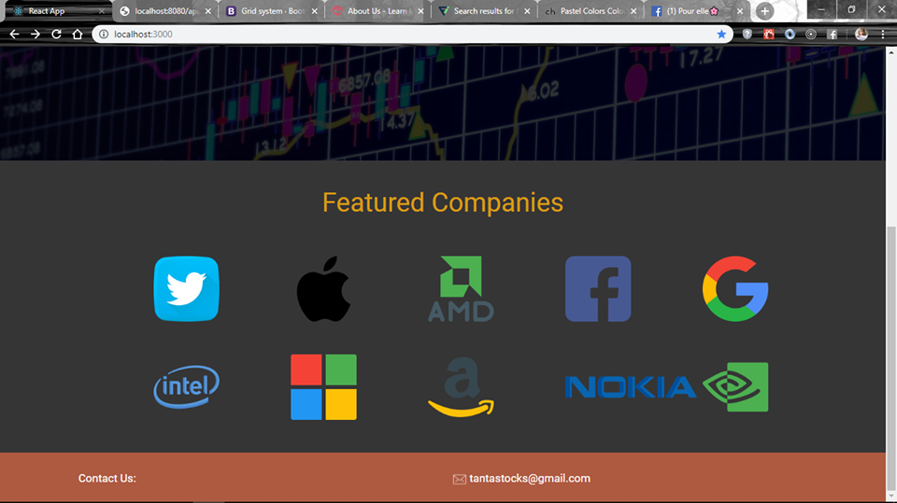
Featured Companies

Slide 20
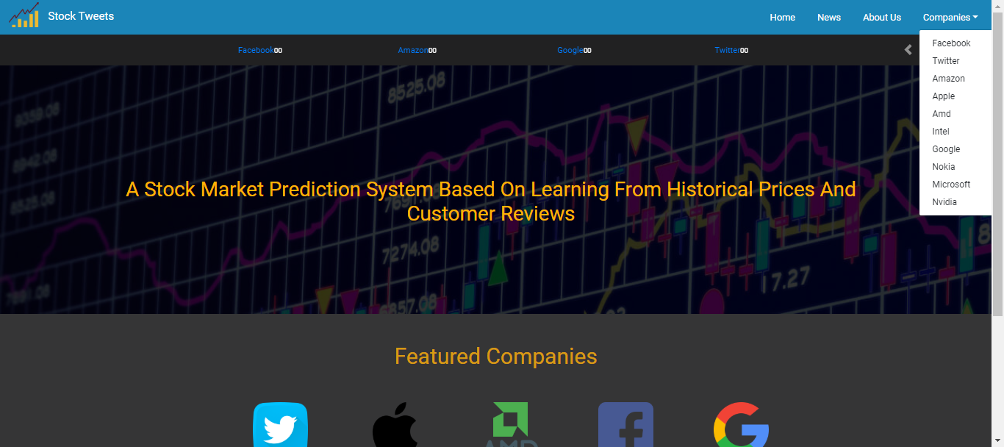
Companies

Slide 21
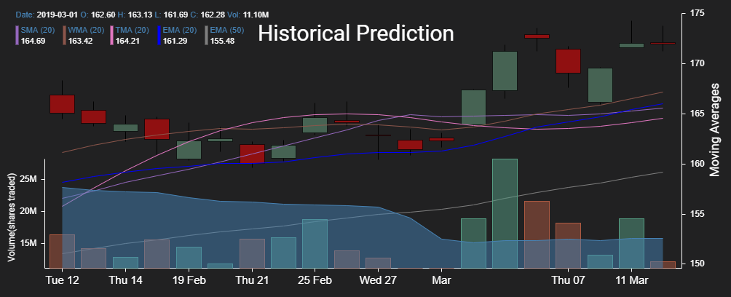
Data Visualization
Is representing data in a visual form. This visual form can be a chart, graphs, lists. This representation helps people to understand the magnitude of the data.
To communicate information clearly and efficiently to users.
Helps data analytics to get better insights.
Data visualization and analytics will draw the conclusions about the datasets.
The Tool We Used:
React Stockcharts: creates highly customizable stock charts built with React js and d3.

Slide 22
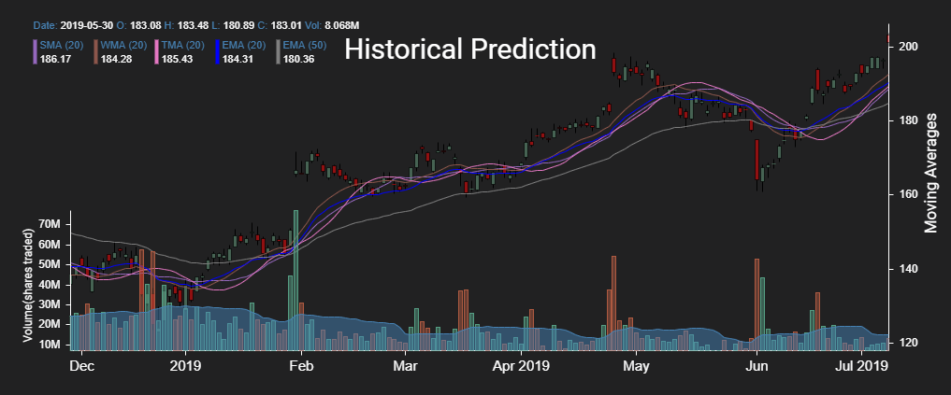
Facebook page
Historical Prices

Slide 23
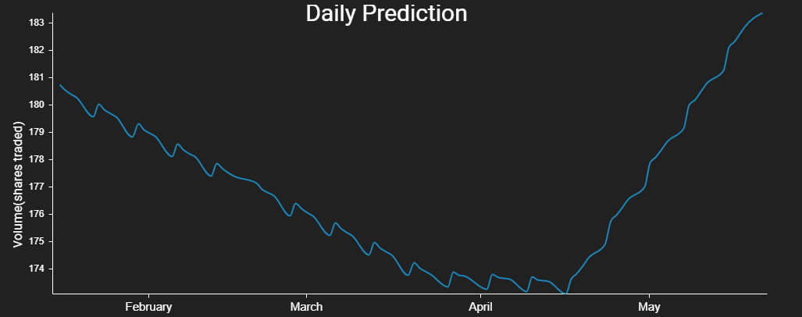
Facebook page
Daily Prediction

Slide 24
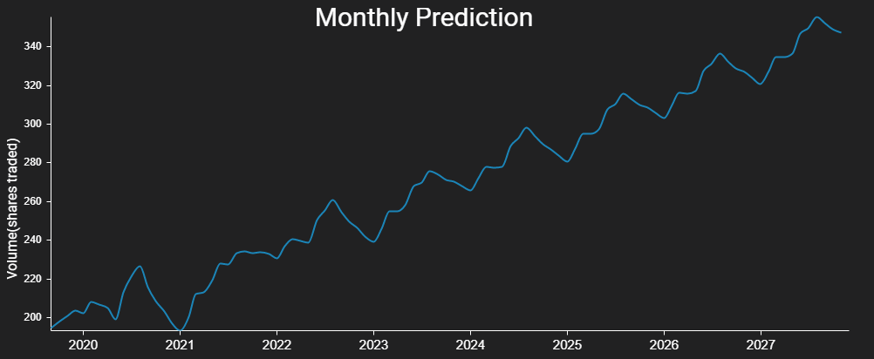
Facebook page
Monthly Prediction

Slide 25
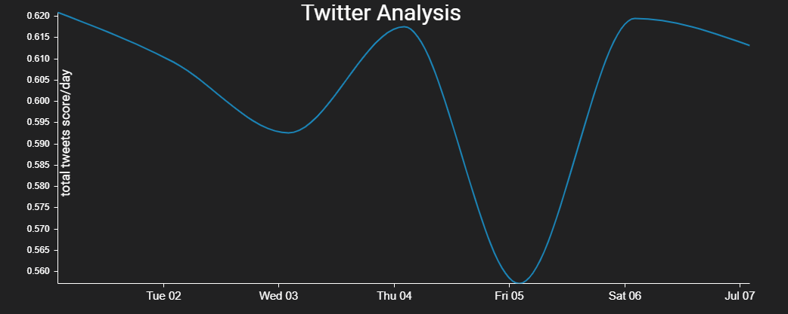
Facebook page
Twitter Analysis

Slide 26

News(Twitter)

Slide 27
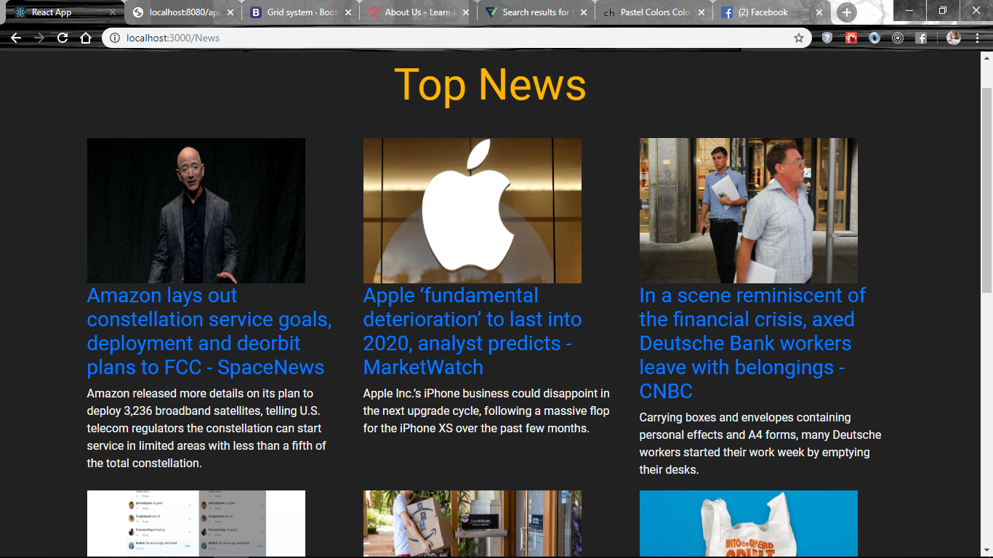
News(Financial News)

Slide 28
04
Back End Development

Slide 29
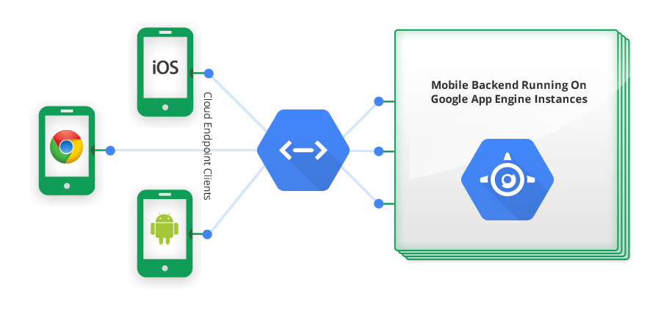
App Engine
What is app engine & features?
Google App Engine is a web framework and cloud computing platform for developing and hosting web applications in Google-managed data centers.

Slide 30
How App engine work?
1-Set up the computer for developing, deploying, and managing the app in App Engine so download SDK.
2-create project and choose the region, we choose us west.
3-we choose nodejs and reactjs in our project so we build the project and deploy the project on app engine.

Slide 31
Connection
Compute Engine
Big query
App Engine
App engine
(website)
Send request for data
Big query
Response Send back json file

Slide 32
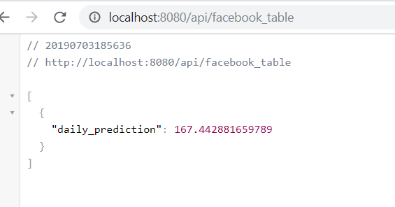
Example
This API call for Facebook stocks prediction.
Call query from bigquery , the result json file
This API call could be local like this

Slide 33
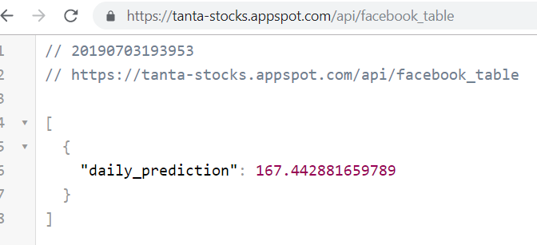
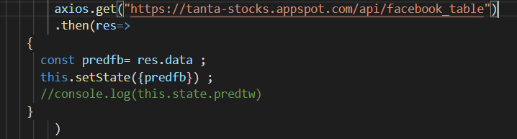
Then after deploy the backend folder on google cloud:
In frontend Use Axios to call API
Axios is a JavaScript library used to make HTTP requests

Slide 34

Deployment
Build react project (frontend).
Deploy with backend server locally.
Deploy on google cloud platform.
http://www.tanta-stocks.appspot.com

Slide 35
05
Historical Data and Prediction

Slide 36
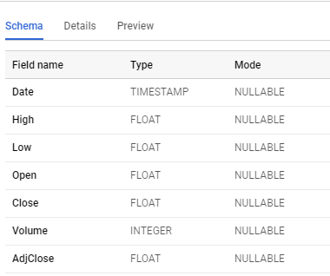
Historical Data
We are using Yahoo Finance stock market data that can be downloaded from their python API.
We gathered stock market data since 2000 until now (almost 18 years).
Our data considers 10 main corporations :
APPLE
AMAZON
FACEBOOK
Intel
Microsoft
AMD
Nvidia
Twitter
Google
Nokia).
Data Schema

Slide 37
Time Series Analysis
Time series is a series of data points indexed (or listed or graphed) in time order.
Most commonly, time-series data is a sequence of observations stored in time order.
Time series analysis is an approach to analyze time series data to extract meaningful characteristics of data and generate other useful insights applied in business situation.
Time series analysis helps understand time-based patterns of a set of metric data points which is critical for any business. Techniques of time series forecasting could answer business questions like how much inventory to maintain, how much website traffic do you expect in your e-store to how many products will be sold in the next month all of these are important time series problems to solve.
As the stock market has two types of clients’ investors and stock brokers, we considered both. So, we have two predictions daily one for the stock brokers and monthly one for the investors. So, we have two models.

Slide 38
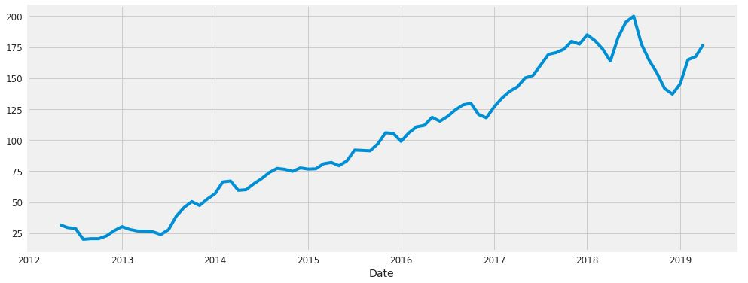
Visualizing Close time series data

Slide 39
ARIMA Model
ARIMA stands for Auto Regressive Integrated Moving Average.
The AutoRegressive (AR) model
specifies that the output variable depends linearity on its own previous values.
Yt = β0 + β1 Yt-1 + β2 Yt-2 + .. + βpYt-p
AR(p) indicates an autoregressive model of order p.
P is the parameter that determine the dependency of the model on the previous terms.
Moving average Model
In statistics, a moving average (rolling average or running average) is a calculation to analyze data points by creating a series of averages of different subsets of the full data set. It is also called a moving mean (MM) or rolling mean
ARIMA is a combination of Auto Regression Model and moving Average Model with difference to make data stationary.
The parameters of the ARIMA model are defined as follows:
• p is the number of autoregressive terms(AR Model)
• q is the number of lagged forecast errors in the prediction equation(MA Model)
• d is the number of nonseasonal differences needed for stationarity(Integration level)

Slide 40
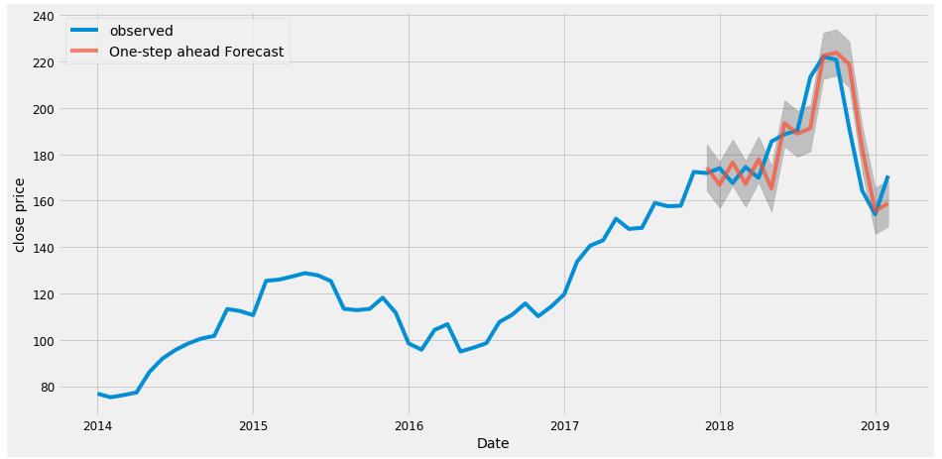
Validating forecasts
To help us understand the accuracy of our forecasts, we compare predicted Close to real close price of the time series

Slide 41
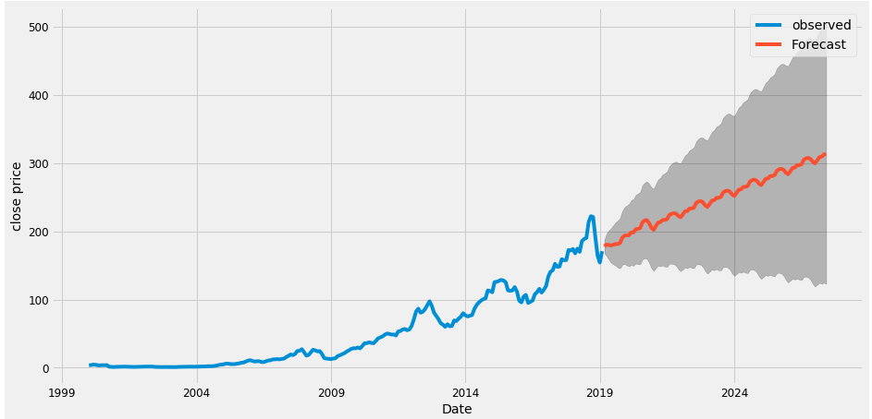
Producing and visualizing forecasts

Slide 42
FBprophet Model
Fbprophet is an open source released by Facebook in order to provide some useful guidance for producing forecast at scale.
Prophet is a procedure for forecasting time series data based on an additive model where non-linear trends are fit with yearly, weekly, and daily seasonality, plus holiday effects.
fbprophet package in Python or R can help us look deeper into the hidden cycles in stock market.
The Prophet uses a decomposable time series model with three main model components: trend, seasonality, and holidays. They are combined in the following equation:
y(t)= g(t) + s(t) + h(t) + εt
• g(t): piecewise linear or logistic growth curve for modeling non-periodic changes in time series.
• s(t): periodic changes (e.g. weekly/yearly seasonality).
• h(t): effects of holidays (user provided) with irregular schedules.
• εt: error term accounts for any unusual changes not accommodated by the model.
The important idea in Prophet is that by doing a better job of fitting the trend component very flexibly, we more accurately model seasonality and the result is a more accurate forecast

Slide 43
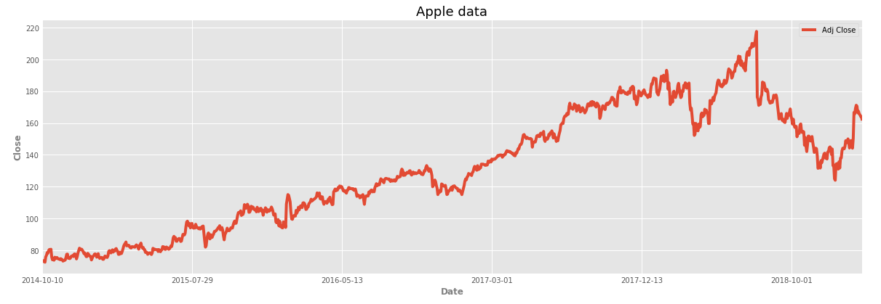
Apple stock price from 2014/10/10 to 2019/2/15

Slide 44
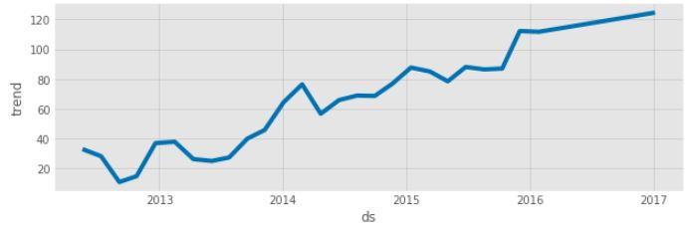
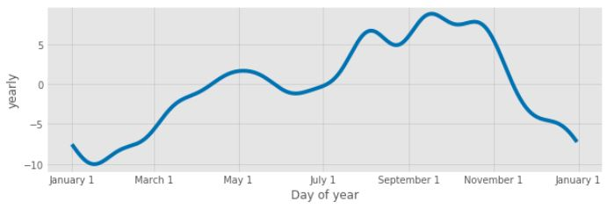
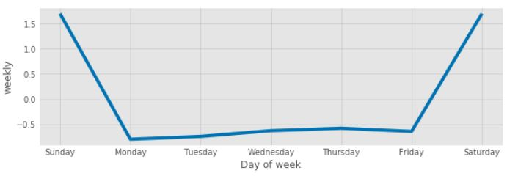
We can also visualize our data according to different components of FBprophet model: weekly, yearly, trend and user-defined cycle

Slide 45
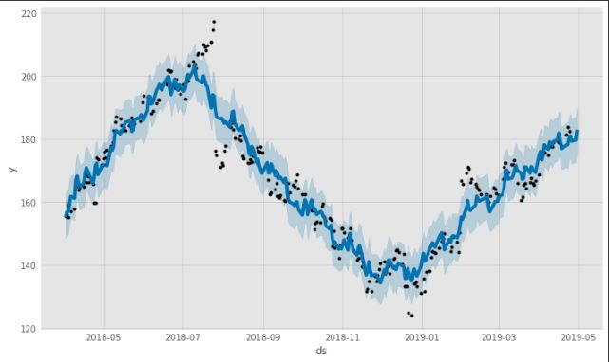
Model validation
In our model we try to use last 12-month data to predict the next 10 days.

Slide 46
06
Twitter Sentimental Analysis

Slide 47
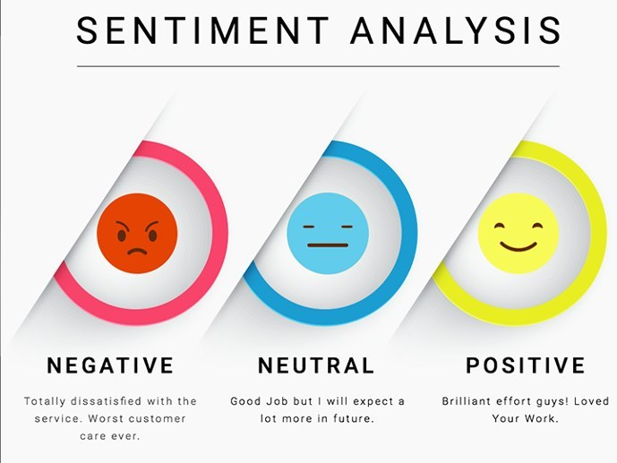
Introduction
Sentiment analysis is mining of text which identifies and extracts subjective information and helping a business to understand the social sentiment of their brand, product or service while monitoring online conversations. However, Sentiment Analysis is the most common text classification tool that analyses an incoming message and tells whether the underlying sentiment is positive, negative our neutral.

Slide 48
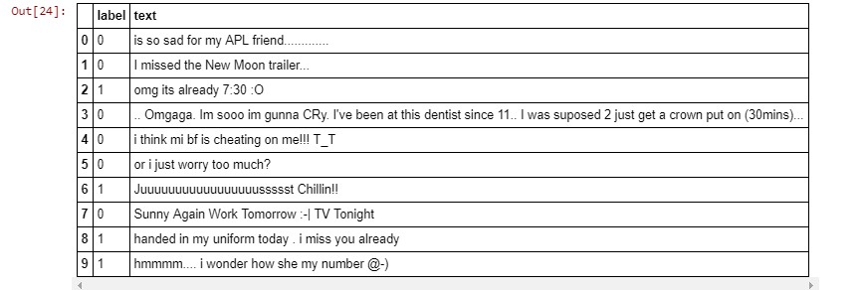
Training Data set
We used training dataset from sentiment140.com. The dataset comes with prelabeled columns containing one of two binary targets. Zero(0) for Negative sentiment and Four(4) for Positive sentiment. The data is made up of about 1.6 million random tweets with corresponding sentiment labels.

Slide 49
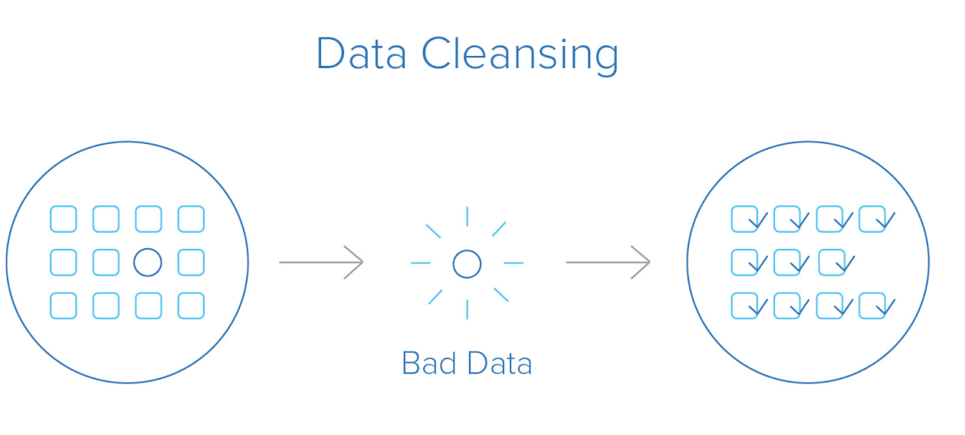
Training data pre-processing
Text pre-processing is important for the sentiment extraction to remove any unnecessary characteristics in the data which would make the final trained model a poor generalizer.
Text pre-processing can involve many things like removing unwanted characters like emojis, properly formatting the text to remove extra spaces or any other information in the text that we don't believe would make a great feature for our model
Pre-processing steps:
Convert @username to AT_USER.
HTML special entities (e.g. & amp;).
Remove tickers.
Make all the text in lower case.
Remove hyperlinks.
Remove hashtags.
Remove Punctuation and split 's, 't, 've with a space for filter.
Remove words with 2 or fewer letters.
Remove whitespace (including new line characters).
Remove single space remaining at the front of the tweet.
Remove characters beyond Basic Multilingual Plane (BMP) of Unicode.

Slide 50
Feature Extraction
We will transform data into tokens and then tokens into features. This is done by Term Frequency, Inverse Document Frequency (TF-IDF).
We'll convert each message which is represented by a list of tokens into a vector that a machine learning model can understand.
Feature Extraction steps:
Count how many times does a word occur in each message (Known as term frequency TF which measures how frequently a term occurs in a document)
Weigh the counts, so that frequent tokens get lower weight (inverse document frequency IDF which measures how important a term is)
TF(t) = (Number of times term appears in a document) / (Total number of terms in the document).
IDF(t) = loge (Total number of documents / Number of documents with term t in it)

Slide 51
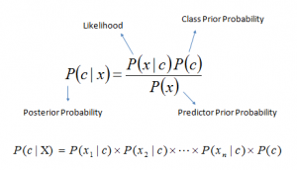
Classifiers
1- Naïve Bayes:
Naive Bayes (NB) classifier which is based on the Bayes Theorem. The NB classifier assumes that the presence of a feature in a class is unrelated to the presence of any other feature. For example, a fruit may be an apple if it is red, round, and about 3” in diameter. A Naive Bayes classifier considers each of these “features” (red, round, 3” in diameter) to contribute independently to the probability that the fruit is an apple, regardless of any correlations between features.
Bayes theorem calculations :
P(c|x) is the probability of class (c, target) given predictor (x, attributes).
P(c) is the probability of class.
P(x|c) is the probability of predictor given class.
P(x) is the prior probability of predictor.

Slide 52

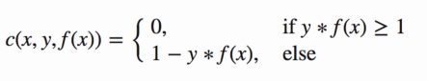
Classifiers
2- Support Vector Machine:
The objective of the support vector machine algorithm is to find a hyperplane in an N-dimensional space (N — the number of features) that distinctly classifies the data points.
It’s based on the concept of decision planes that define decision boundaries. To separate the two classes of data points, there are many possible hyperplanes that could be chosen. Our objective is to find a plane that has the maximum margin, i.e. the maximum distance between data points of both classes. Maximizing the margin distance provides some reinforcement so that future data points can be classified with more confidence.
Cost Function
In the SVM algorithm, we are looking to maximize the margin between the data points and the hyperplane. The loss function that helps maximize the margin is hinge loss.

Slide 53
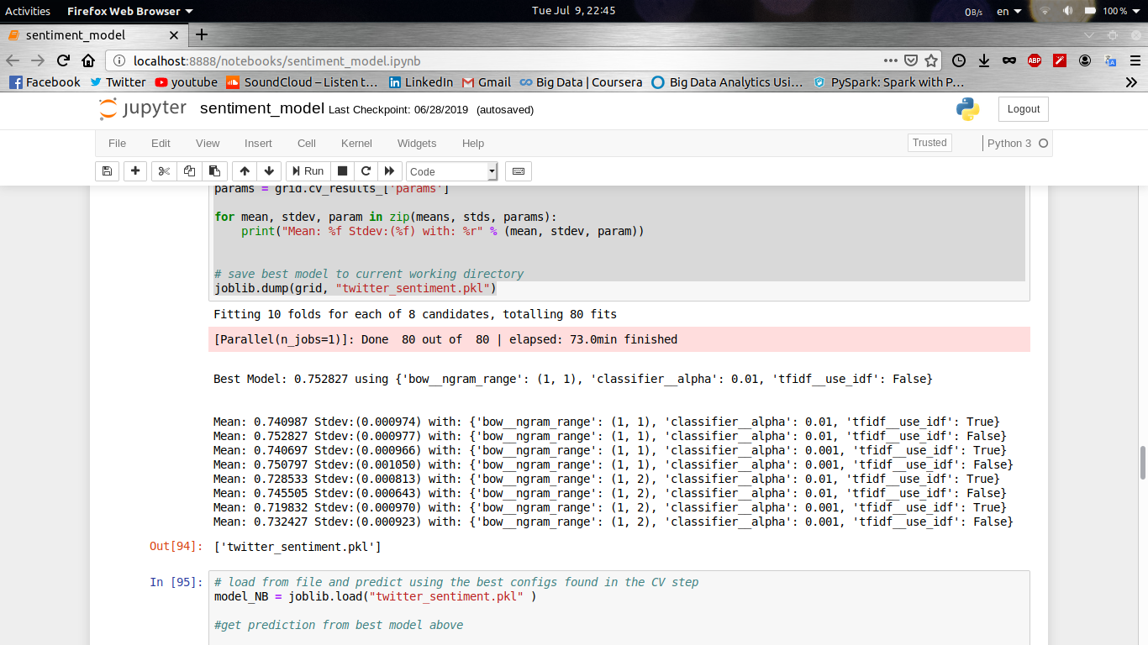
Naïve Bayes Training
The recommended method for training a good model is to first cross-validate using a portion of the training set itself to check if you have used a model with too much capacity (i.e. if the model is overfitting the data).
We use the KFold strategy to split the model into random parts to find out if it's generalizing well or if it's overfitting.
For our case, there are 4 + 2 + 2=8 parameter combinations to test and 10 KFold validations, so the model will be trained and tested on the validation set 8 x 10 = 80 times.

Slide 54
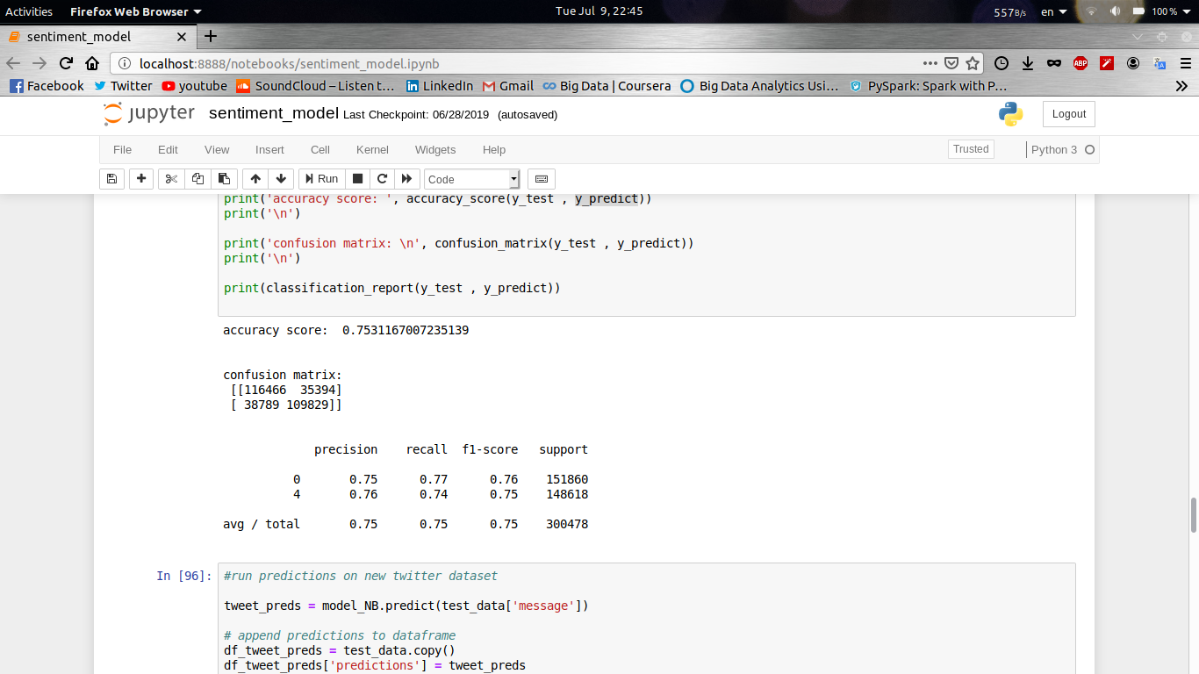
Naïve Bayes score
I used the best model to perform predictions to the unseen test data which lets us grade and retrieve the performance metrics.
From the confusion matrix:
The model predicted 116466 labels correctly as Negative and 109829 labels correctly as Positive.
We also got 38789 labels predicted as Positives even though they are Negatives (False Negatives).
Another thing we can tell from the CM is that the model predicted 35394 labels as Negatives, but they turned out to be Positives (False Positives).
From the classification report:
Precision: 75% for label 0 and 76% for label 4. This number tells us what proportion of the labels were predicted correctly out of the total predictions for that class.
Recall: 77% for label 0 and 74% for label 4. This is the number of correct predictions out of true labels for that class.
f1 -score: It’s the weighted average of precision and recall for that class. 76 % for label 0 and 75% for label 4.

Slide 55
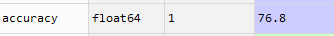
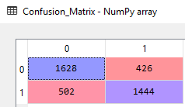
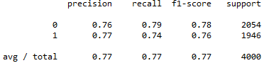
SVM score
After training with the same technique used with NB model with the same data, I used the best model to perform predictions to the unseen test data
From the confusion matrix:
The model predicted 1628 labels correctly as Negative and 1444 labels correctly as Positive.
We also got 426 labels predicted as Positives even though they are Negatives (False Positives).
Another thing we can tell from the CM is that the model predicted 502 labels as Negatives, but they turned out to be Positives (False Negative).
From the classification report:
Precision: 76% for label 0 and 77% for label 1. This number tells us what proportion of the labels were predicted correctly out of the total predictions for that class.
Recall: 79% for label 0 and 74% for label 1. This is the number of correct predictions out of true labels for that class.
f1 -score: It’s the weighted average of precision and recall for that class. 78% for label 0 and 76% for label 1.

Slide 56
07
Natural language processing (NLP)

Slide 57
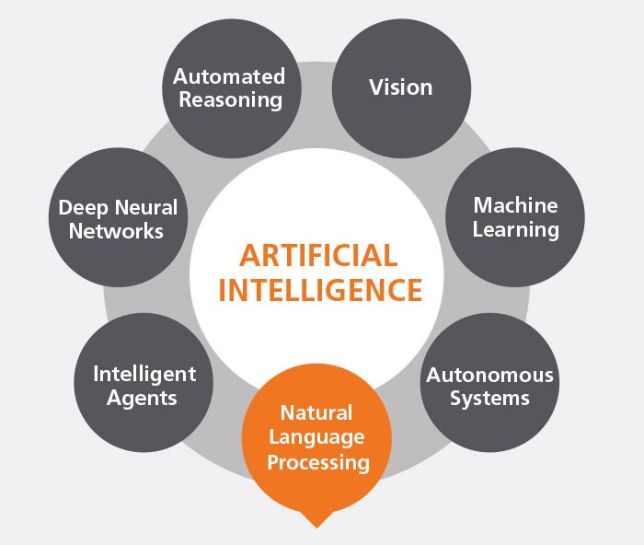
Introduction
Natural Language Processing (NLP) is the field of Artificial Intelligence
concerned with the processing and understanding of human language.
Since its inception during the 1950s, machine understanding of language
has played a pivotal role in translation, topic modeling, document indexing,
information retrieval, and extraction.

Slide 58
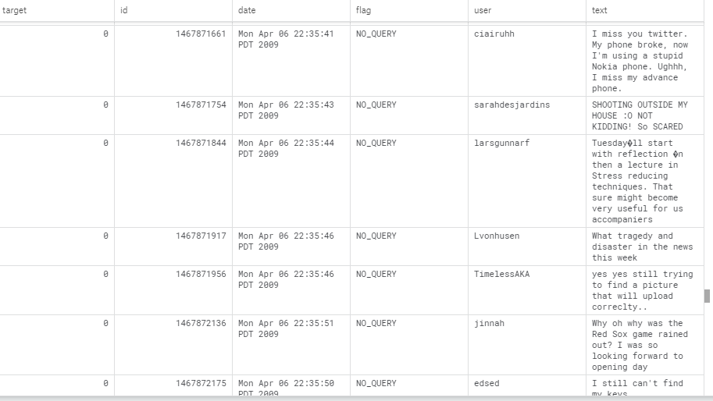
Data sample
We use Kaggle Dataset contains 1,600,000 tweets extracted using the twitter ApI.

Slide 59

Data Cleaning
Text preprocessing is technique that transforms raw data into an understandable format. Raw data(real world data) is always incomplete and that data cannot be sent through a model. That would cause certain errors. That is why we need to preprocess data before sending through a model.
Preprocessing steps:
1- lowering words.
2- remove punctuation.
3- remove hyperlinks.
4-remove unused fields.

Slide 60
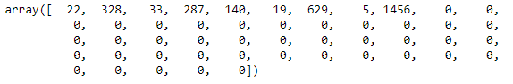
Feature Extraction
We will transform tokens(words) into features. This is done by word embedding. Word Embedding is the texts converted into numbers and there may be different numerical representations of the same text. many Machine Learning algorithms and almost all Deep Learning Architectures are incapable of processing strings or plain text in their raw form They require numbers as inputs to perform any sort of job, be it classification, regression etc. A Word Embedding format generally tries to map a word using a dictionary to a vector.
Feature Extraction steps:
1- Tokenize sentence into words or tokens. Each word take an integer id . Start indexing from1.
2- Convert sentence into vector of numbers by replacing each word by its integer id .(To_sequence_function)
3- padding sequence mean when there are multiple sentence with different length ,we are in need to make them equal in length vector.

Slide 61
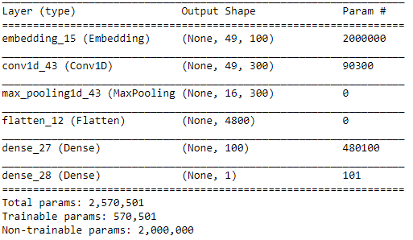
Model Architecture

Slide 62
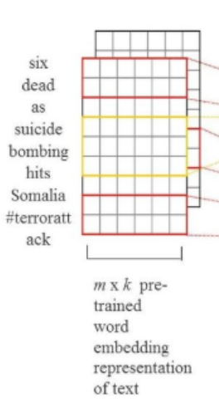
Model Layer description:
1- Embedding Layer:
we can think of the Embedding layer as a dictionary
that maps an index assigned to a word to a word vector.
This layer is very flexible and can be used in a few ways:
a-The embedding layer can be used at the start of
a larger deep learning model.
b-Also, we could load pre-train word embeddings into
the embedding layer when we create our model.

Slide 63
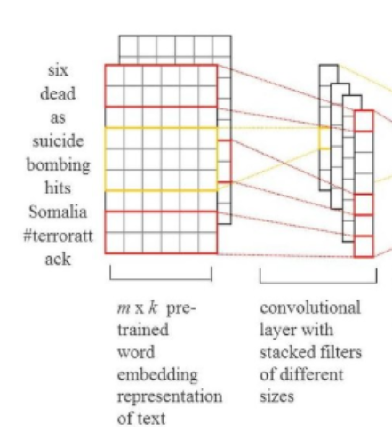
Model Layer description:
2- Convolution layer:
After we come out of embedding layer, we want to get feature
descriptor for whole of text, so we use neural network over this
embedding. To analyze n-grams in our text, we just convolve
the word vectors that are near, you can think of it as sliding
window walk on our word vector matrix. You need to track
many n-grams, that's why you need a lot of convolutional filters.
And these filters are called 1D convolutions because we
slide the window only in one direction.

Slide 64
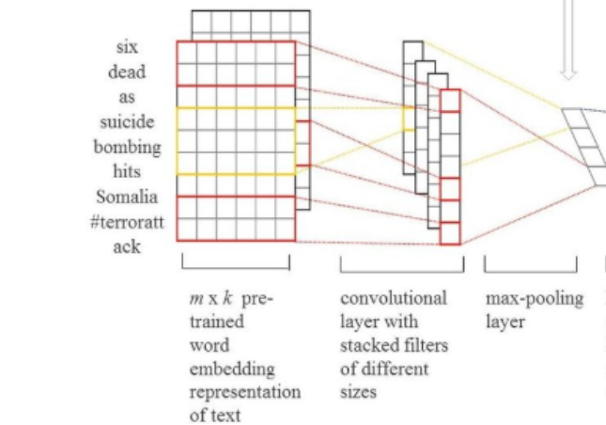
Model Layer description:
3- Maxpooling layer:
is a sample-based discretization process.
The objective is to down-sample an input
representation (image, hidden-layer
output matrix, etc.), reducing its
dimensionality , we do maximum pooling
overtime and, we apply multiple filter with
different length and finally we got vector is
a kind of embedding of our input sequence.

Slide 65
Model Layer description:
4- Flatten layer:
Does not affect the batch size. The purpose of this argument is to preserve weight ordering when switching a model from one data format to another
5- Dense layer :
Two dense layer are used in our architecture one with relu activation function , another one with sigmoid
6- dropout layer:
This layer prevent overfitting .

Slide 66
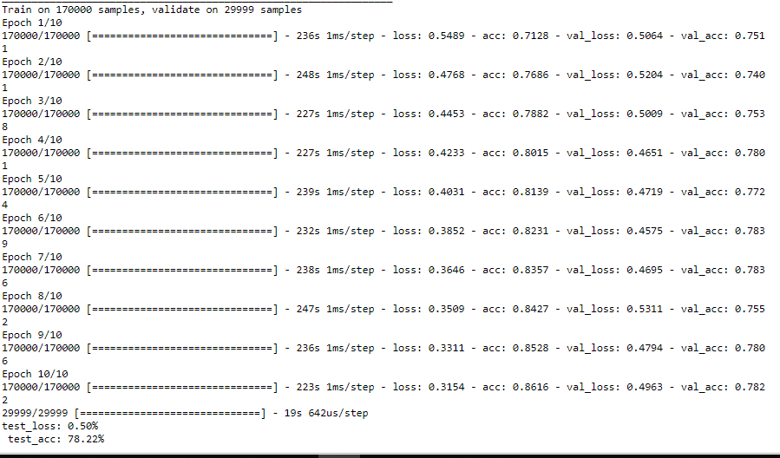
Model Training

Slide 67
NLP using Deep learning
Deep learning has emerged as a powerful machine learning technique that learns multiple layers of representations or features of the data and produces state-of-the-art prediction results. Along with the success of deep learning in many other application domains, deep learning is also popularly used in sentiment analysis in recent years.

Slide 68
08
Enhancement

Slide 69
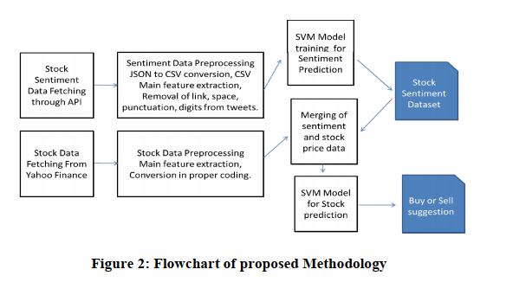
1- Sell/Buy Model
Approach
we extracted tweets from API, processed them for Natural Language Processing (NLP) and sentiment analysis. After predicting sentiment, we extracted historical data from Yahoo Finance. We then developed a model for stock market prediction using stock price data and sentiment score to predict the change in stock market. The proposed methodology for predicting the stock market movement through sentiment analysis showed in the following figure:

Slide 70
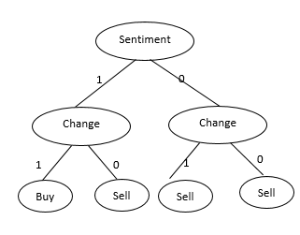
SVC Model
We used SVM model to suggest whether a person should buy or sell a share. We applied some preprocessing on the data as we created new columns to present the class if it is 1 or 0 (buy or sell) so we can train the model. In the training we told the model if it found the sentiment analysis is 1 and the change in the price is positive then it suggests that person should buy, otherwise the person should sell the share.
We achieved 98% accuracy for the SVC model we used to merge the customer reviews with the stock predictions
BUY
SELL

Slide 71
2- Polynomial Regression Model
In statistics, polynomial regression is a form of regression analysis in which the relationship between the independent variable x and the dependent variable y is modelled as an nth degree polynomial in x. Polynomial regression fits a nonlinear relationship between the value of x and the corresponding conditional mean of y, denoted E(y | x). Polynomial regression is considered to be a special case of multiple linear regression.
This is the general equation of a polynomial regression is:
Y=θo + θ₁X + θ₂X² + … + θₘXᵐ + residual error
We developed a polynomial regression model to enhance our daily prediction using the score we get from NLP analysis of tweets and customer reviews. We used a second-degree model to fit our data. We used 70% of the data for training the model and 30% for the evaluation.

Slide 72
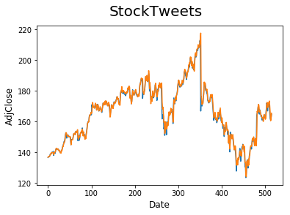
2- Polynomial Regression Validation

Slide 73

3- CNN Model
We use 3 hidden layers (Conv2D, MaxPooling2D and Dense). And input of size (1,7,7). We use RELU function for all of them.
Conv2D
Conv2D of 64 neurons.
MaxPooling2D
Pool size = (1, 2).
Dense
Dense of 30 neurons

Slide 74
3- CNN Model Architecture
Input Layer 49 neurons
Conv2D 7*7*64
MaxPooling2D 1*2*64
Dense 7*7*32
Output Layer

Slide 75

3- CNN Model Architecture

Slide 76

3- CNN Model Validation

Slide 77

Evaluation
Sell/Buy Model
Accuracy = $\frac{TP+TN}{TP+TN+FP+FN}$
We achieved 98.8% accuracy for the SVC model we used to merge the customer reviews with the stock predictions.
Actual / predicted | True | False
True | 35 | 1
False | 0 | 63

Slide 78
Evaluation
Model | MSE | RMSE | EVS | R2
CNN | 4.567077 | 6.52544 | 0.86388 | 0.86266
Polynomial | 8.4125 | 2.9 | 0.9731 | 0.9724
FBprophet | 6.6753 | 9.219508 | 0.73108 | 0.73107

Slide 79
09
Future Work

Slide 80



Data
Researchers have explored the power of verbal information on stock markets due to the observation of stock price fluctuations with news feed.
So that we propose using financial news and Facebook feed news of users (considered as customers reviews) addition to twitter tweets to enhancement the prediction of the stock market considering all Web media factors that effect on stock predictions and increase number of companies we offer in our website.

Slide 81

prediction
There are so many factors involved in the prediction – physical factors vs. psychological, rational and irrational behavior, etc. All these aspects combine to make share prices volatile and very difficult to predict with a high degree of accuracy.
We will work with historical data about the stock prices of listed companies. We will implement a mix of machine learning algorithms to predict the future stock price of this companies, by using advanced techniques Long Short Term Memory (LSTM). LSTMs are widely used for sequence prediction problems and have proven to be extremely effective. The reason they work so well is because LSTM can store past information that is important and forget the information that is not.

Slide 82
Application
The number of mobile users today is greater than the number of desktop users!
Consequently, we have realized the need to effectively use mobile channels for attracting customers. So, we proposed starting new operations (or scaled existing ones) through mobile apps.
So that, we proposed to offer a new mobile application on both IOS and Android platforms to serve more customers and make our customers feel more personalized. As we intend to expand our prediction to include large number of companies and stock markets in different countries. So, personalization of the app to be suitable for each specific customer is our reasonability.
We will offer high level of personalization by using machine learning algorithms that offer new stocks, interested financial news and feed backs and financial analysis to the customer according to his balance in trading and interests.
we Also proposed to develop an electronic trading application to allow our customers buy/sell stock shared based on our predictions, analysis and recommendation to the customer. The mobile app will be bonus in such e-trading application as buying/selling stock shares need you to be update 24 hours, get frequently notifications, privacy and security.

Slide 83

Thank You
Insert the Sub Title of Your Presentation

